Slide 1
LET’S PLAY
https://leolasz.github.io/Star-wars---tic-tac-toe/index.html

Slide 2



Slide 3

GAME PAGE STEPS
0 – PLANNED ON OF A PIECE OF PAPER
1 - create function for TURN
2 - create function for RESULT
3 - create functions with area (s) for click base area in html
4 - create a function for verify winner
5 - create standards for win (I created
8 standards of possibilities to win the game) step
6- create alert for the winner using tag alert or in DRAW CASES .
7 - create function in DRAW CASESGE
HOMEPAGE STEPS
1-creation of the page structure
2- creation of DIV's for each square
3- css tyle
4 audio tag opening the website.
5 onclick audio tag
6 – create link

Slide 4
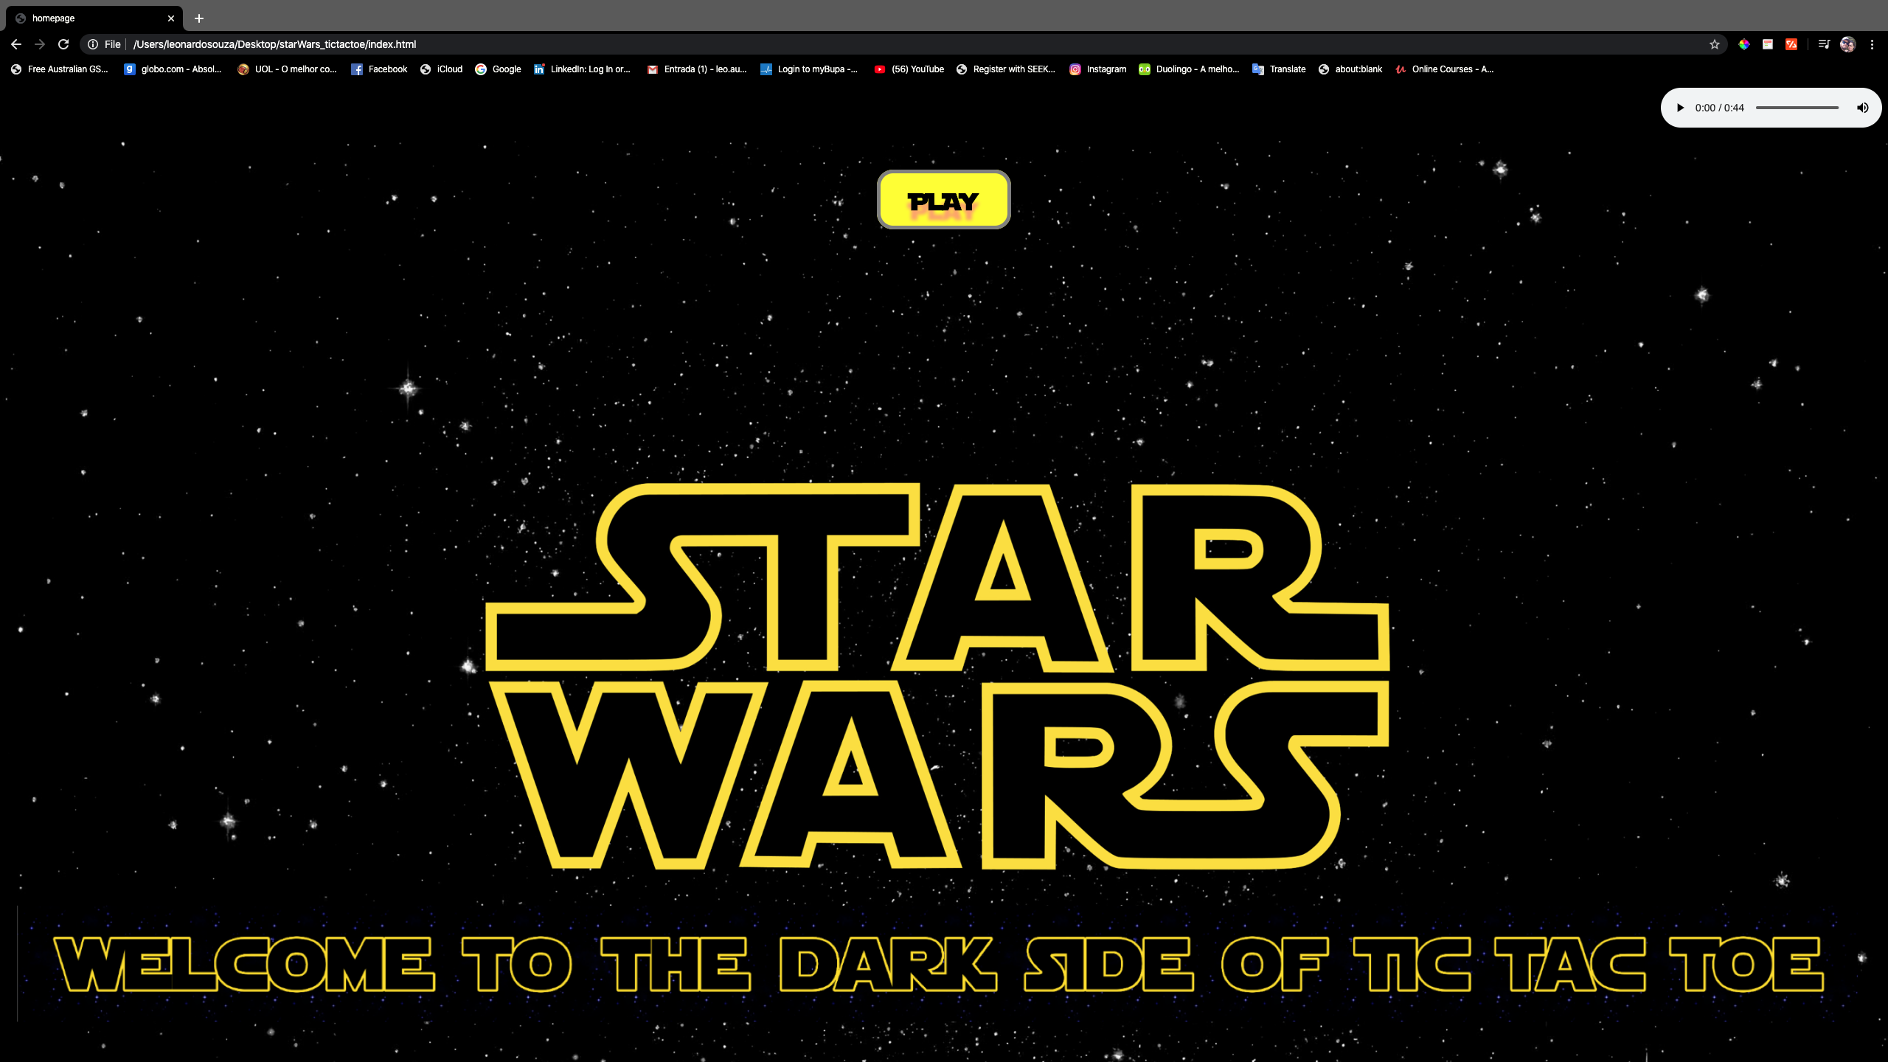

Slide 5
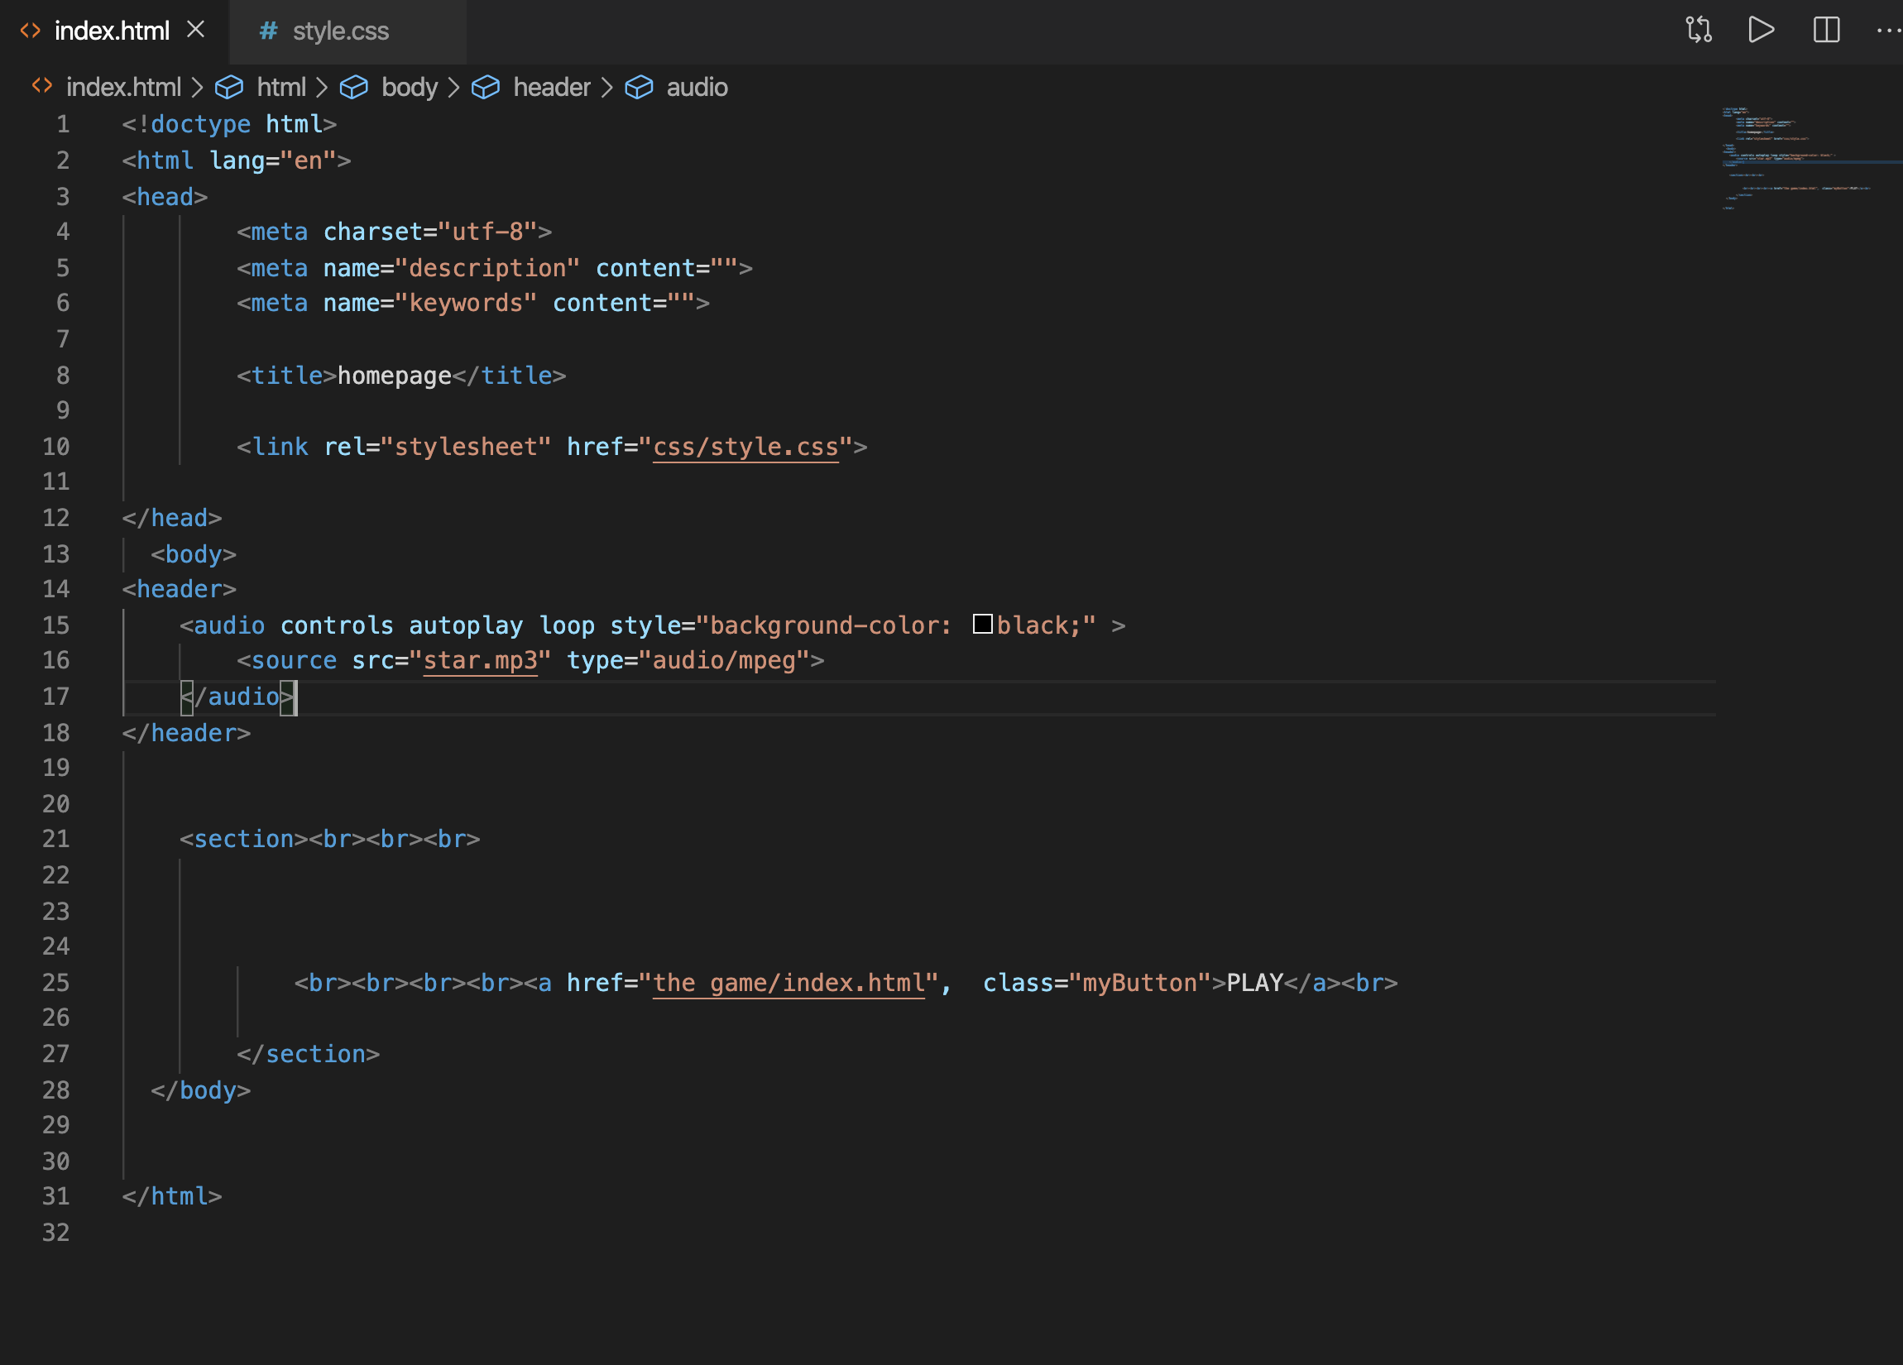
HTML HOMEPAGE

Slide 6
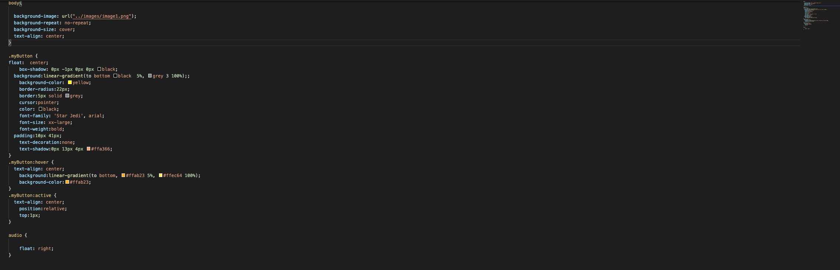
CSS HOMEPAGE

Slide 7
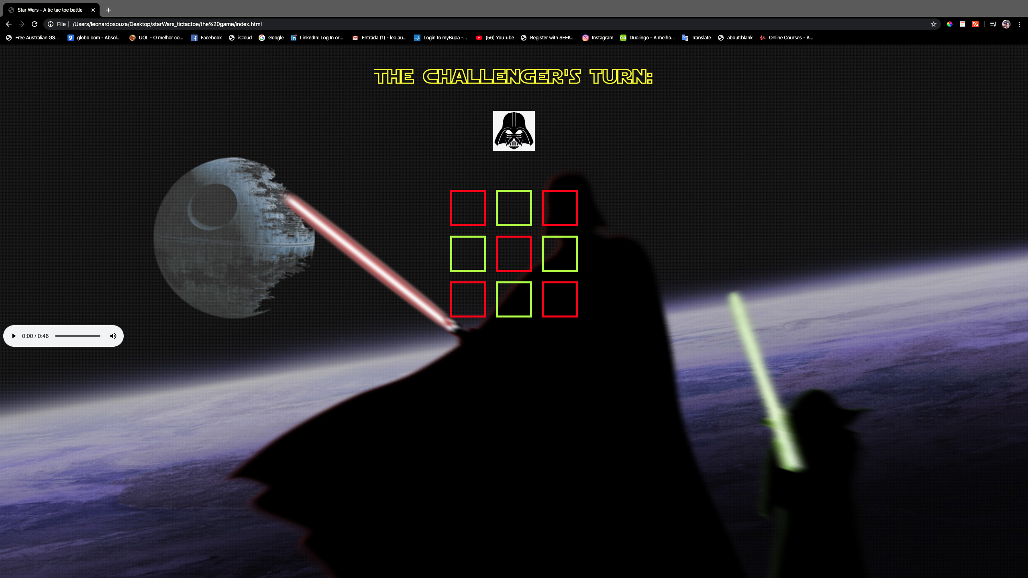

Slide 8
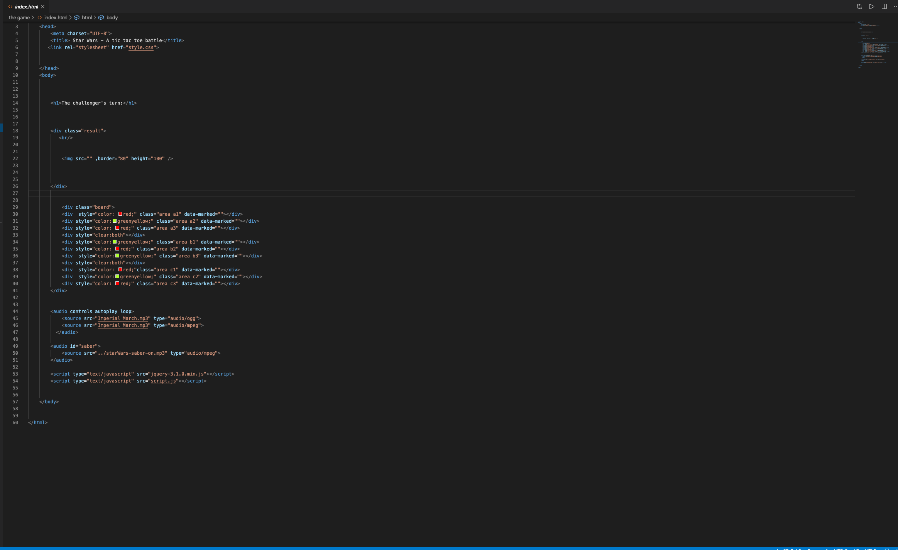
HTML GAME PAGE

Slide 9
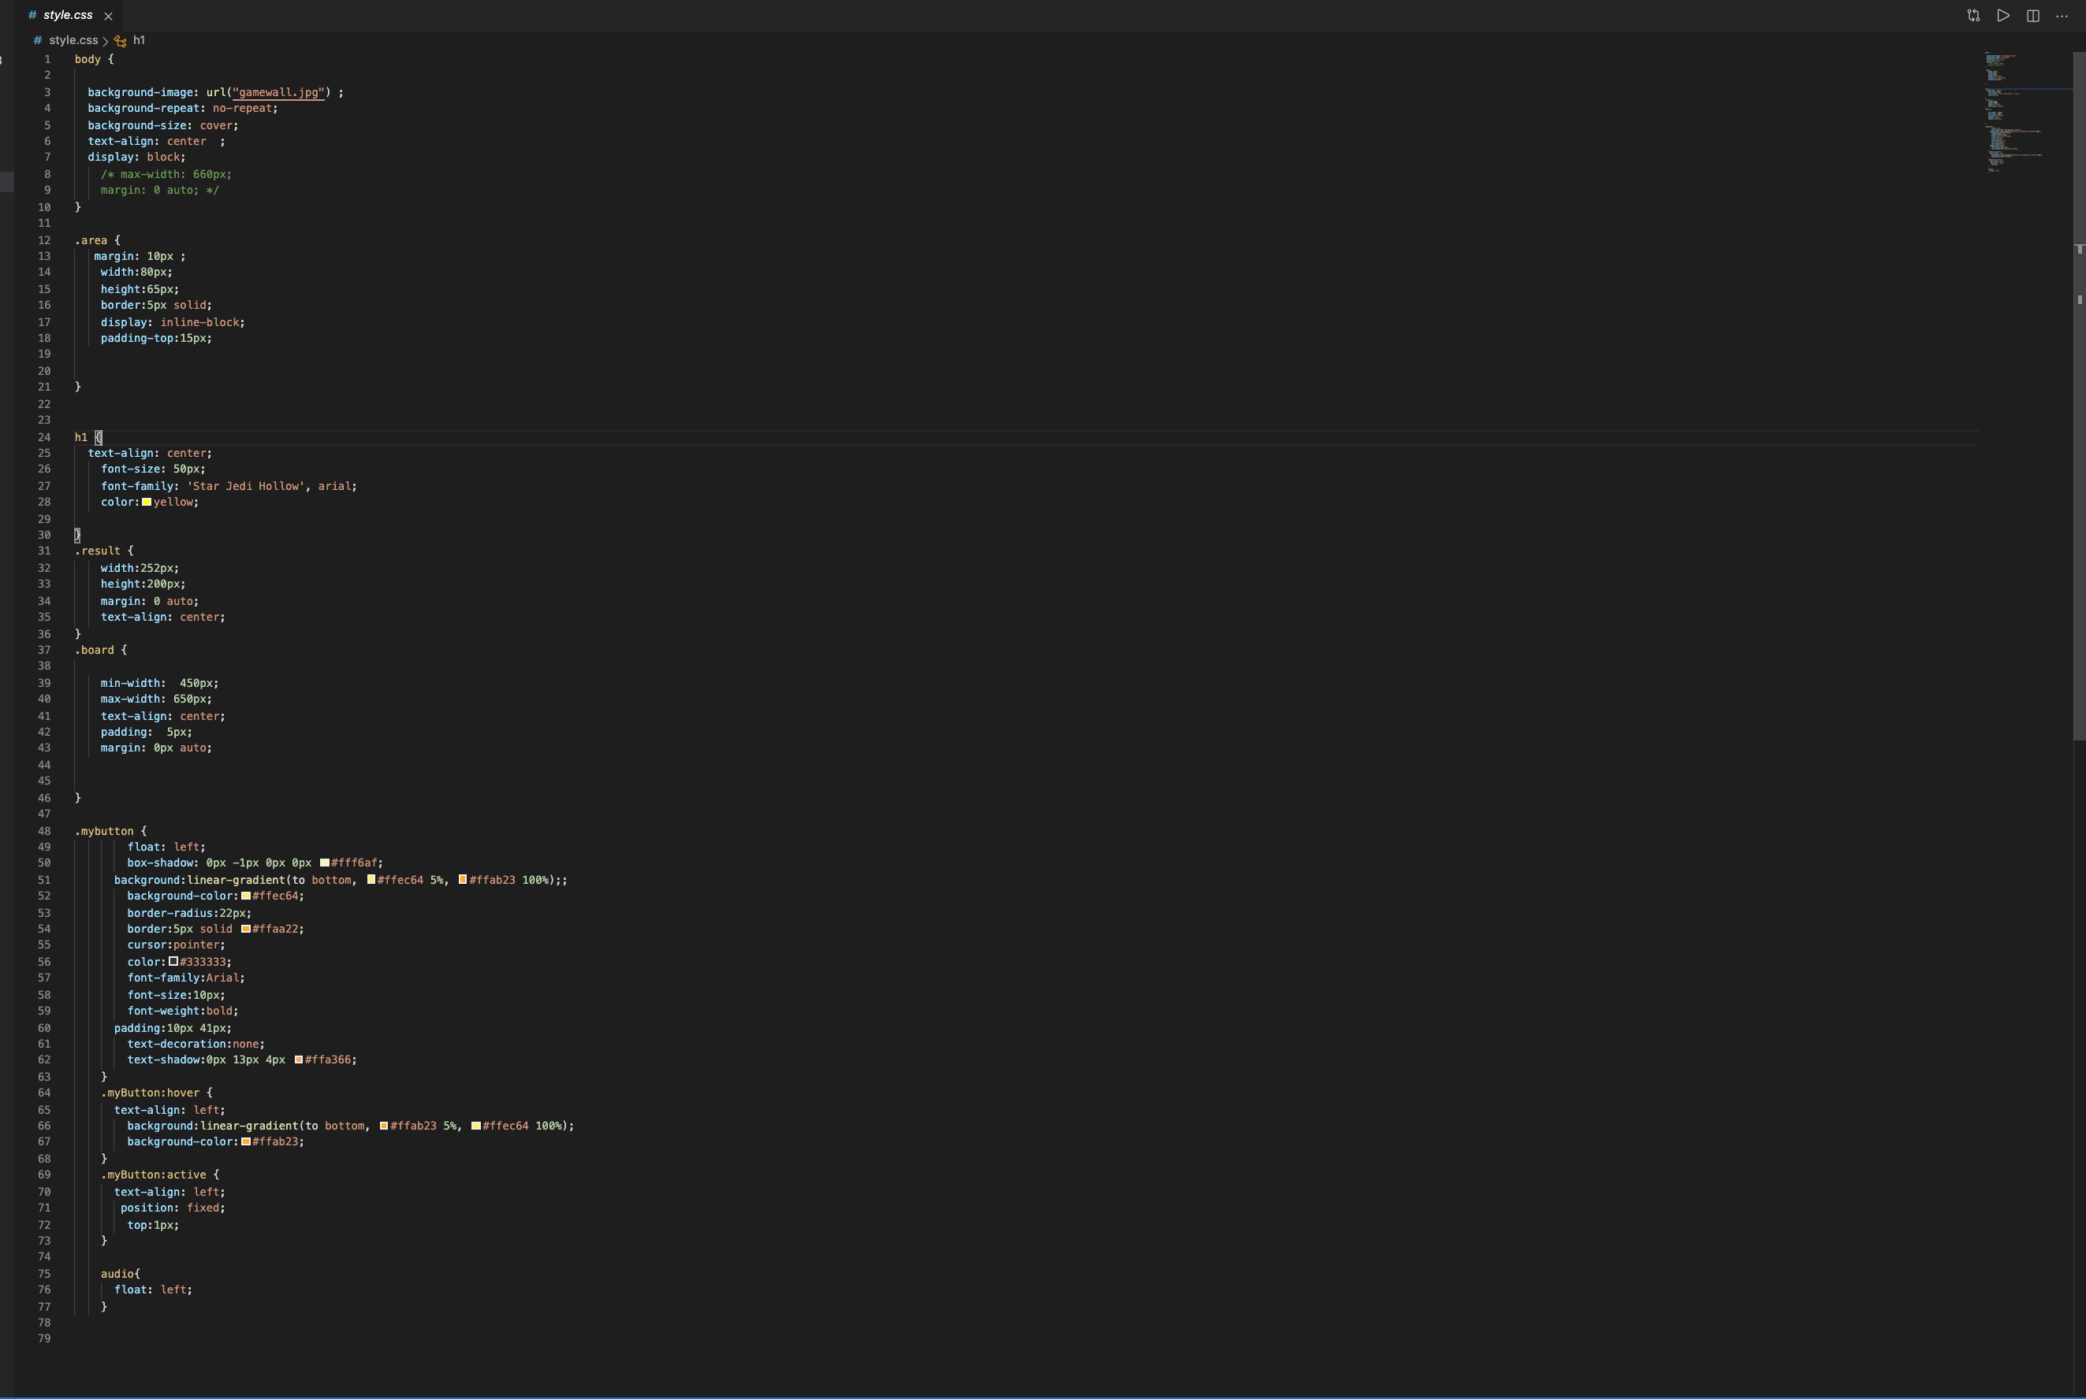
CSS GAME PAGE

Slide 10
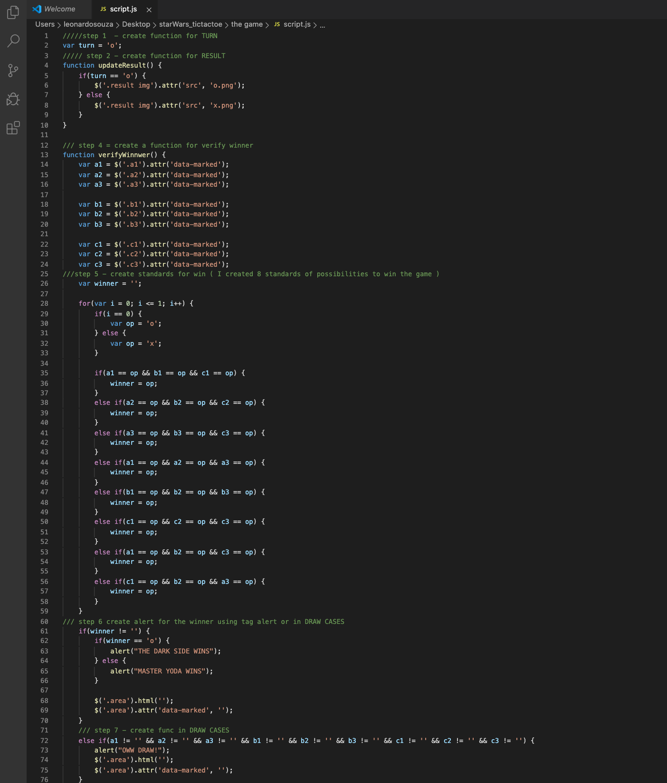
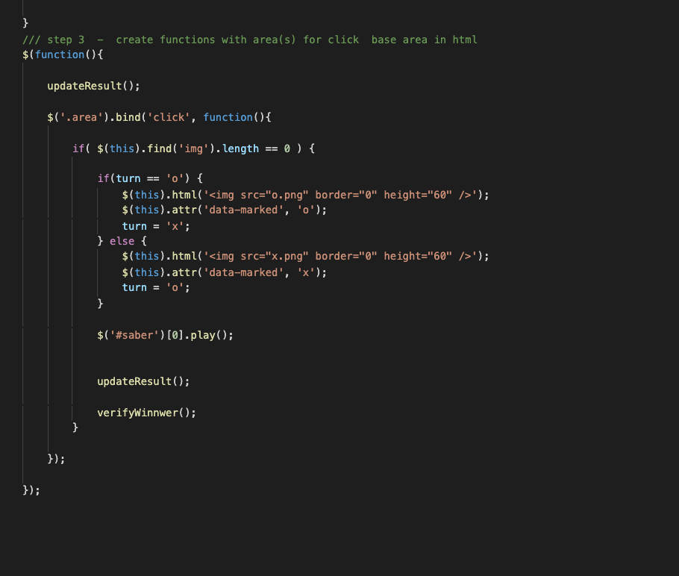
JS GAME PAGE
Cont..

Slide 11
WHAT I’ LEARNED??????????
IMPROVE MY HTML
IMPROVE MY CSS
AVOID FLOAT TAG
IMPROVE MY JS
I THINK …. FINALLY UNDERSTOOD PUTTING THE IF/ELSE.
NEVER GIVE UP
MY CHALLENGES
START THE PROJECT
TRANSLATE MY IDEAS INTO THE CODE FORM
USE JQUERY
FINALLY UNDERSTOOD PUTTING THE IF/ELSE
FOR MY NEXT PROJECTS
PUT MORE ANIMATIONS

